Slide 1
Customizing the Visual Studio Start Page

Slide 2
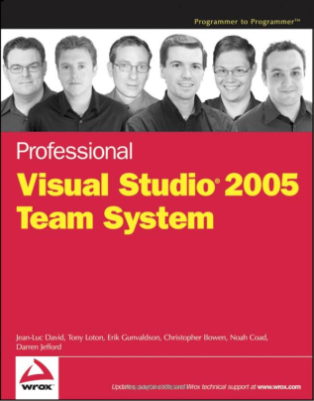

Who is this guy?
Noah Coad, coad.net, coadblog.com, @noahcoad
LifeNexus Chief Technology Officer, http://lifenexus.com
Microsoft Visual Studio Program Manager (2004-2010), shipping VSTS 2005, VSTS 2008, VS Pro 2010
An author of Professional Visual Studio Team System by Wrox Press
Awarded Microsoft C# MVP in 2003
Just moved back to Dallas from Seattle in June
Hobbies: electronic microcontrollers, ice hockey, banjo playing

Slide 3
Get to the code

Slide 4
Summary
WPF page with hooks into VS through commands and DTE
Project Template from Online Gallery (link)
Access to the VS object modal through DTE

